Slide 1
GDP 1 Project Manager Briefing
Group D

Slide 2
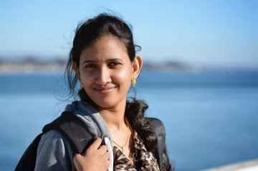
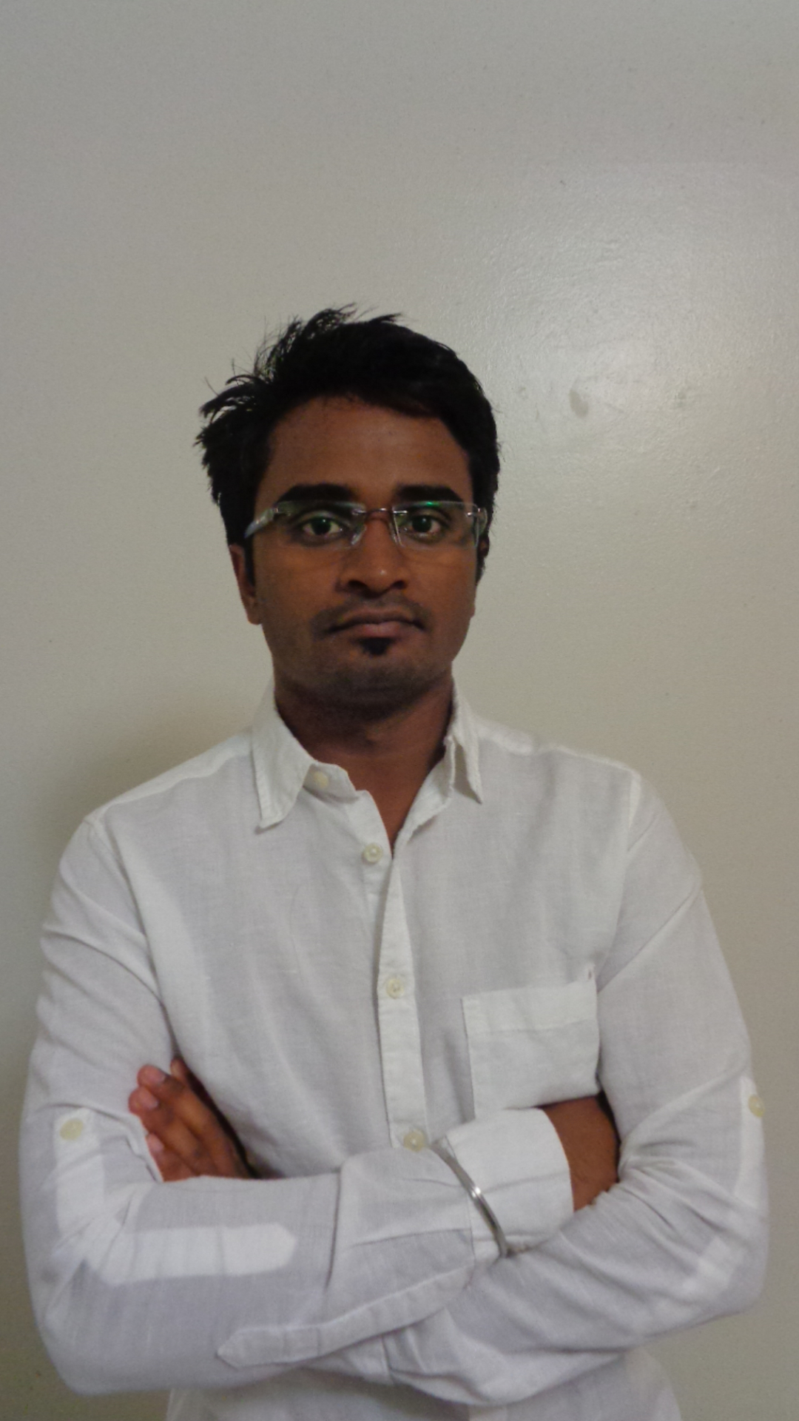
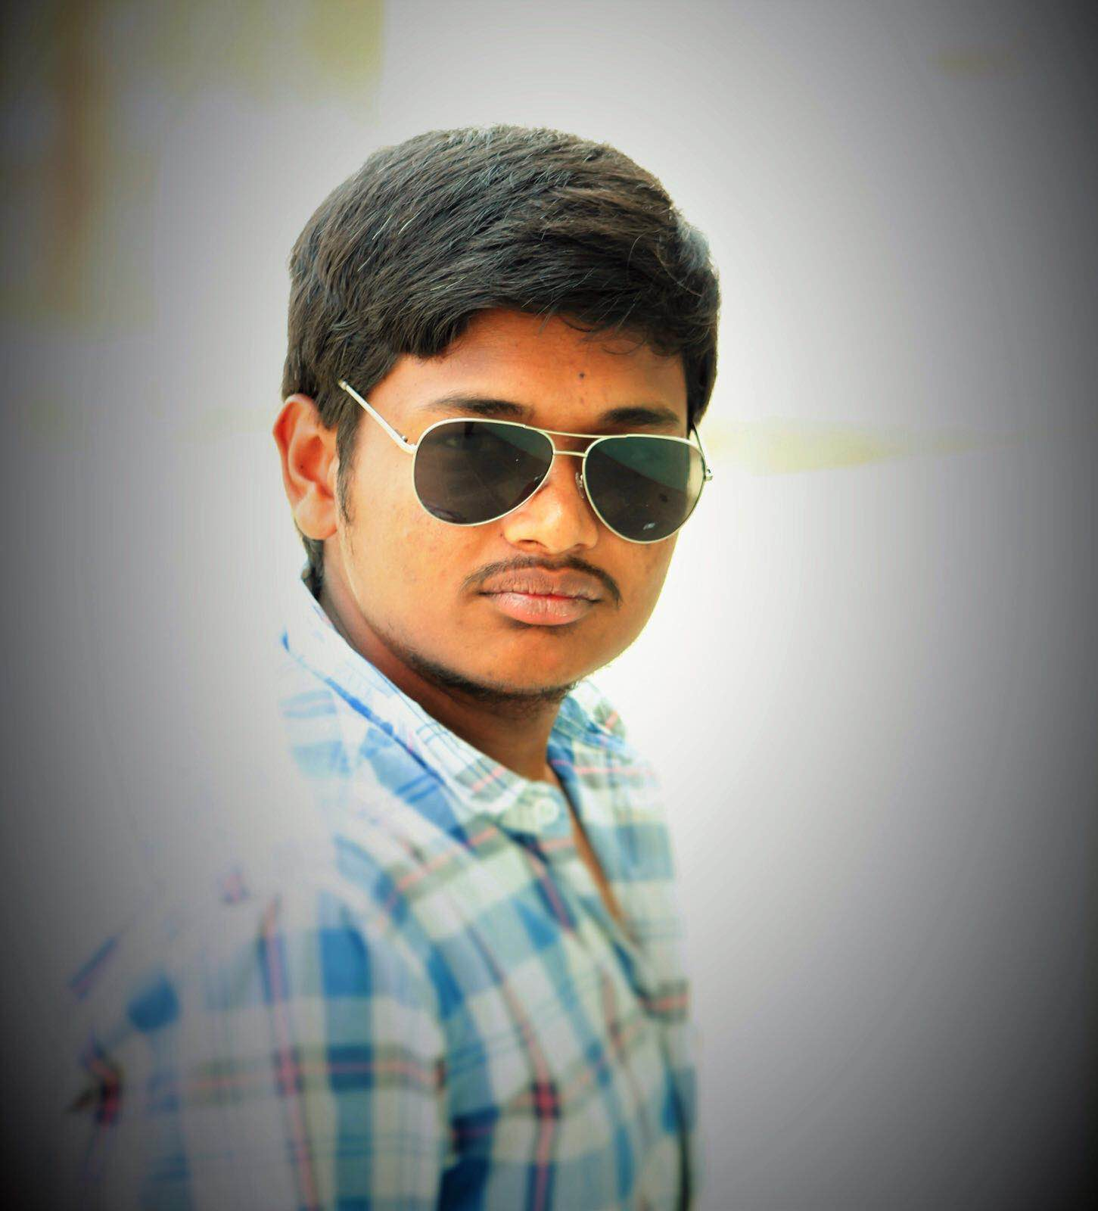
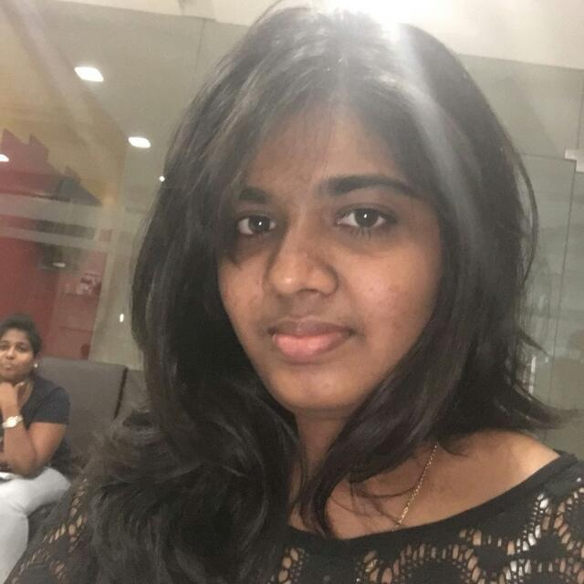
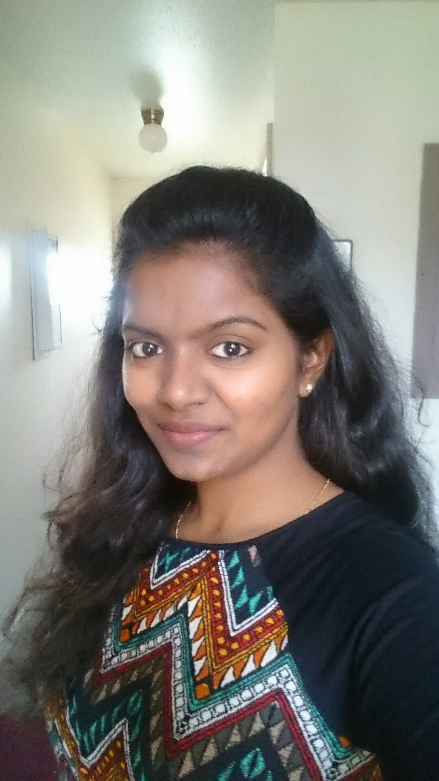
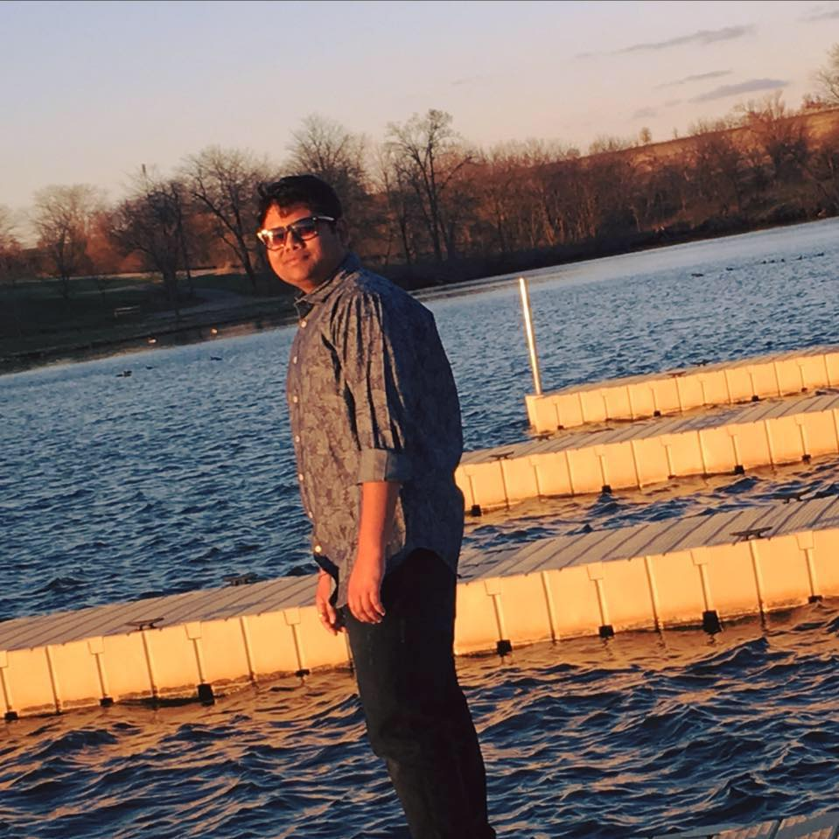
Team Sigma
Sanket
Harika
Niteesha
Sai Kiran
Nikhil
Sravya

Slide 3
Team member responsibilities
S.No. Names Roles
1 Sravya Kandepu - Primary contact & Communications and documentation management
2 Nitheesha Kotagiri - Quality and testing management
3 Nikhil Kumar Vemula - Data management
4 Harika Malempati - Issues management
5 Sanket Selokar - Requirements management
6 Saikiran Gandam - Client management

Slide 4
Client Information
Dr. Michael Oudshoorn
Office: Colden Hall 2147
Phone: 660-562-1764
Email: oudshoorn@nwmissouri.edu

Slide 5
Course scheduling assistant
Faculty Scheduler:
This project enables the faculty to view their schedule automatically. Earlier this is done manual in an excel sheet and given to faculty to see their course schedule.

Slide 6
Project Stack
Java
Swing
Java script
Ajax
JQuery
Advanced Java Script
Mongo DB
Sql

Slide 7
Development environment
Net Beans IDE
Sublime editor

Slide 8
Build Tools
Maven

Slide 9

Source Code Hosting Site
Github

Slide 10
Other Teams We Are Working With
We collaborating with Group – C for testing.

Slide 11
GDP 1 Artifacts
User stories / use cases
Requirements document
User interface storyboards / sketches
Test plan
Architectural prototype

Slide 12

Thank You

